Slide 1
Cost Metric for Evaluation of Parallel OpenMP Codes
CSE 530 Project Presentation
Bodhisatwa Chatterjee
bxc583@psu.edu

Slide 2
Outline of this presentation
Parallelism Overview
Problem of getting multiple parallel versions of a sequential problem
Cost Metric to distinguish these versions

Slide 3
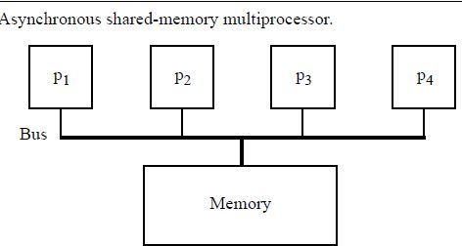
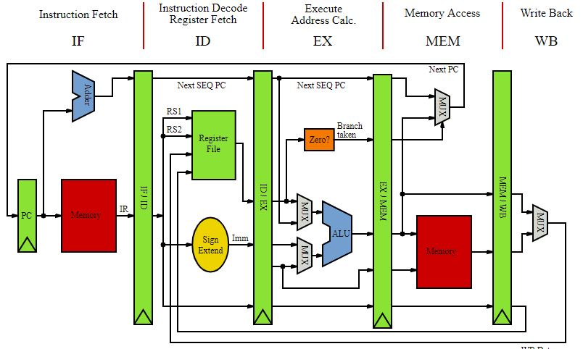
Parallelism is Indispensable
Pipelining was the earliest application
Processor Parallelism (Synchronous & Asynchronous)
Multiple functional units, multiple issue instruction units to facilitate parallel execution

Slide 4
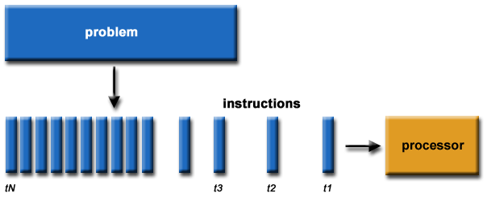
Need to utilize these resources
Having fast hardware is not sufficient
Need to have software taking advantage of these resources
Need to make sure that our code exhibits parallel behaviour

Slide 5
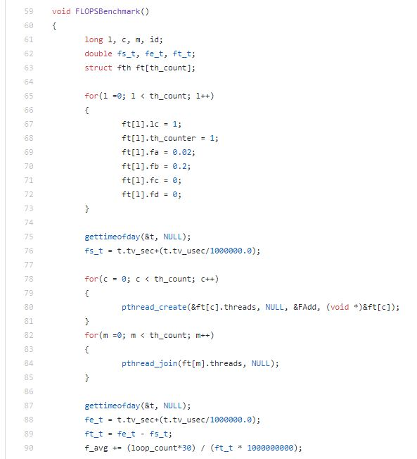
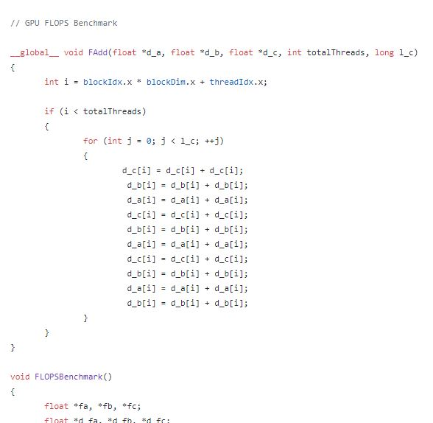
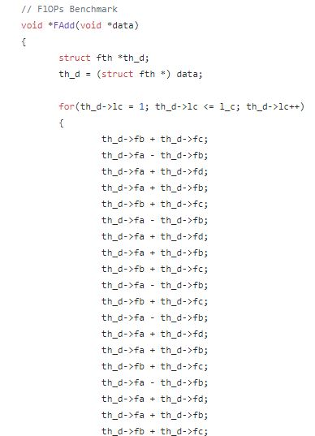
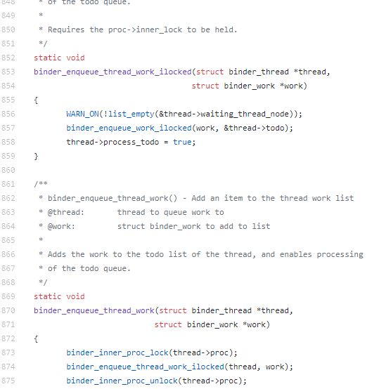




Scope for Parallelism in Workloads?

Slide 6
Focus is to parallelize LOOPS
Owing to their iterative nature
Toy Example
Basic idea is to execute each iteration in parallel
Parallel Execution:
i = 0 i = 1 ........…….…. i = 10
A[0]=0 A[1]=1 A[10]=10
P0
P1
P10

Slide 7
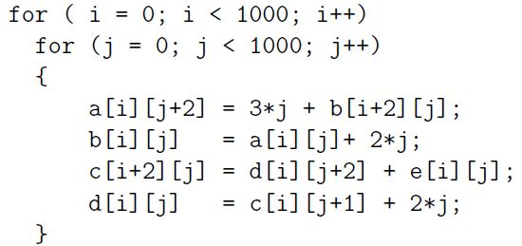

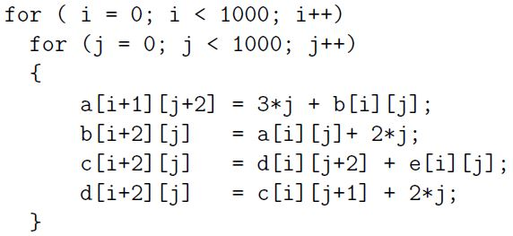


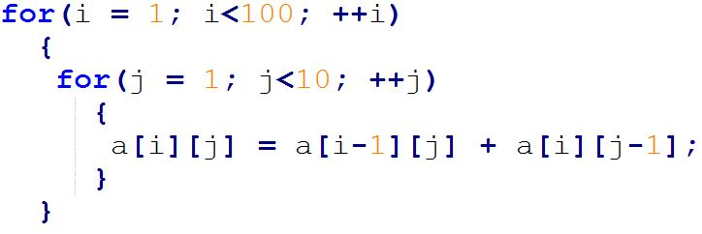
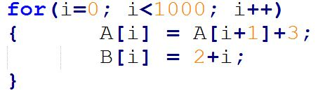
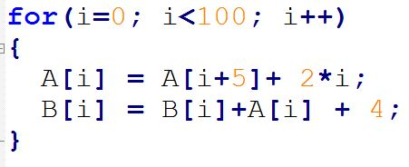
Is life always that easy?
Dependencies!!

Slide 8
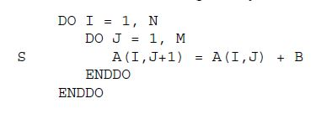
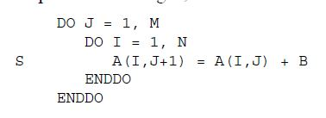
Need transformations to resolve dependencies whenever possible
Loop interchange, Loop normalization, Loop unrolling, etc
Simple transformation enabled parallelization of the inner loop.

Slide 9
End up with multiple versions of parallel codes
Parallel codes depends on specific loop transformations and the order in which they are applied
Types of transformations and their order depends upon the parallel framework/model (Polyhedral Model, Unimodular framework, Presbuyer Framework) and different tools use different frameworks
Frameworks are high level abstractions to perform loop transformations

Slide 10
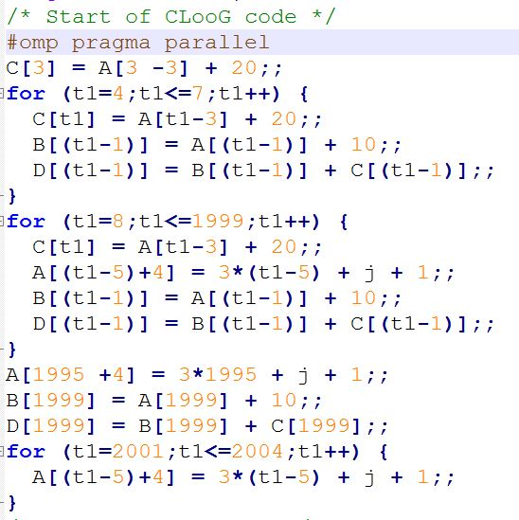
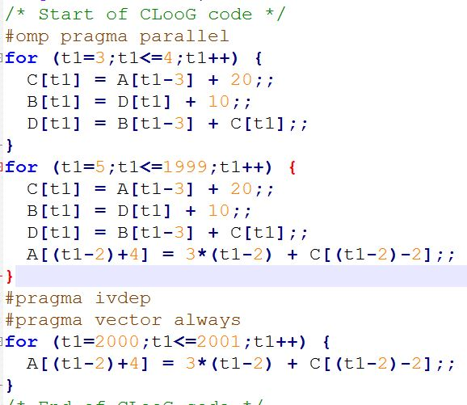



Distinguishing multiple versions of parallel codes

Slide 11
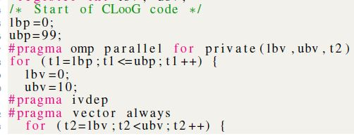
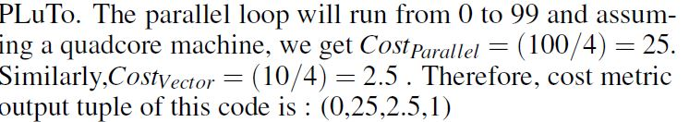
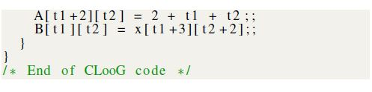
Cost Metric
Basic Idea: Need to find the number of iterations of each type of loops statically
Each iteration is defined as an unit cost
Cost Metric has number of iterations of each loops and a synchronization cost as its parameters

Slide 12
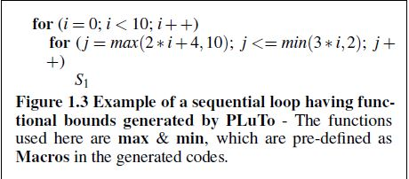
Calculating Iterations is not always easy
Loops with functional bounds
Often bounds are not known at compile time
Derived two novel methods to calculate iterations of loops with functional bounds

Slide 13
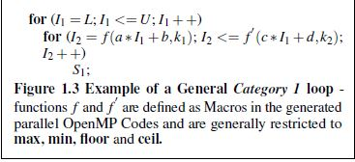
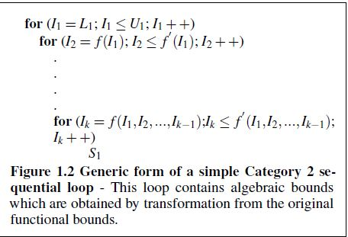
Point of Inflection and Critical Point Analysis
Two methods which deal with functional bounds
Point of Inflection is used to double level nested loop with functional bounds
Critical point analysis deals with n-level nesting with algebraic bounds

Slide 14
Future Work
Addition of more parameters to the cost metric (function call, arrays as pointers)
Design of a tool to calculate cost metrics of OpenMP Codes

